Slide 1


Quantum Curriculum in the US: Quantifying the instructional time, content taught, and paradigms used
Alexis Buzzell, Ramón Barthelemy, Tim Atherton
University of Utah, Department of Physics & Astronomy
Tufts University, Department of Physics & Astronomy

Slide 2

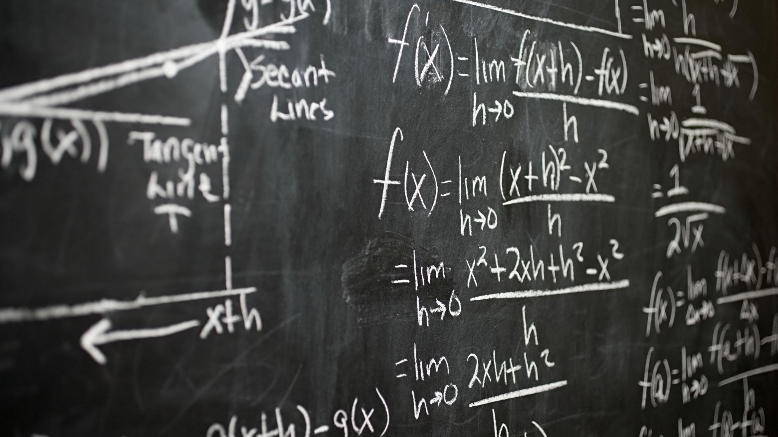
Q1: How many courses on quantum concepts are physics students required to complete to be awarded a four-year degree?
Buzzell Quantifying the Quantum Curriculum 2

Slide 3
190 institutions with graduate degrees in physics offered [1]
Buzzell Quantifying the Quantum Curriculum 3

Slide 4
190 institutions with graduate degrees in physics offered [1]
188 institutions offer a 4-year degree in physics
Buzzell Quantifying the Quantum Curriculum 3

Slide 5
190 institutions with graduate degrees in physics offered [1]
188 institutions offer a 4-year degree in physics
74.5% R1 Institutions
22.3% R2 Institutions
6 institutions not classified [2]
Buzzell Quantifying the Quantum Curriculum 3

Slide 6
190 institutions with graduate degrees in physics offered [1]
188 institutions offer a 4-year degree in physics
74.5% R1 Institutions
22.3% R2 Institutions
6 institutions not classified [2]
69.7% Public
30.3% Private [2]
Buzzell Quantifying the Quantum Curriculum 3

Slide 7
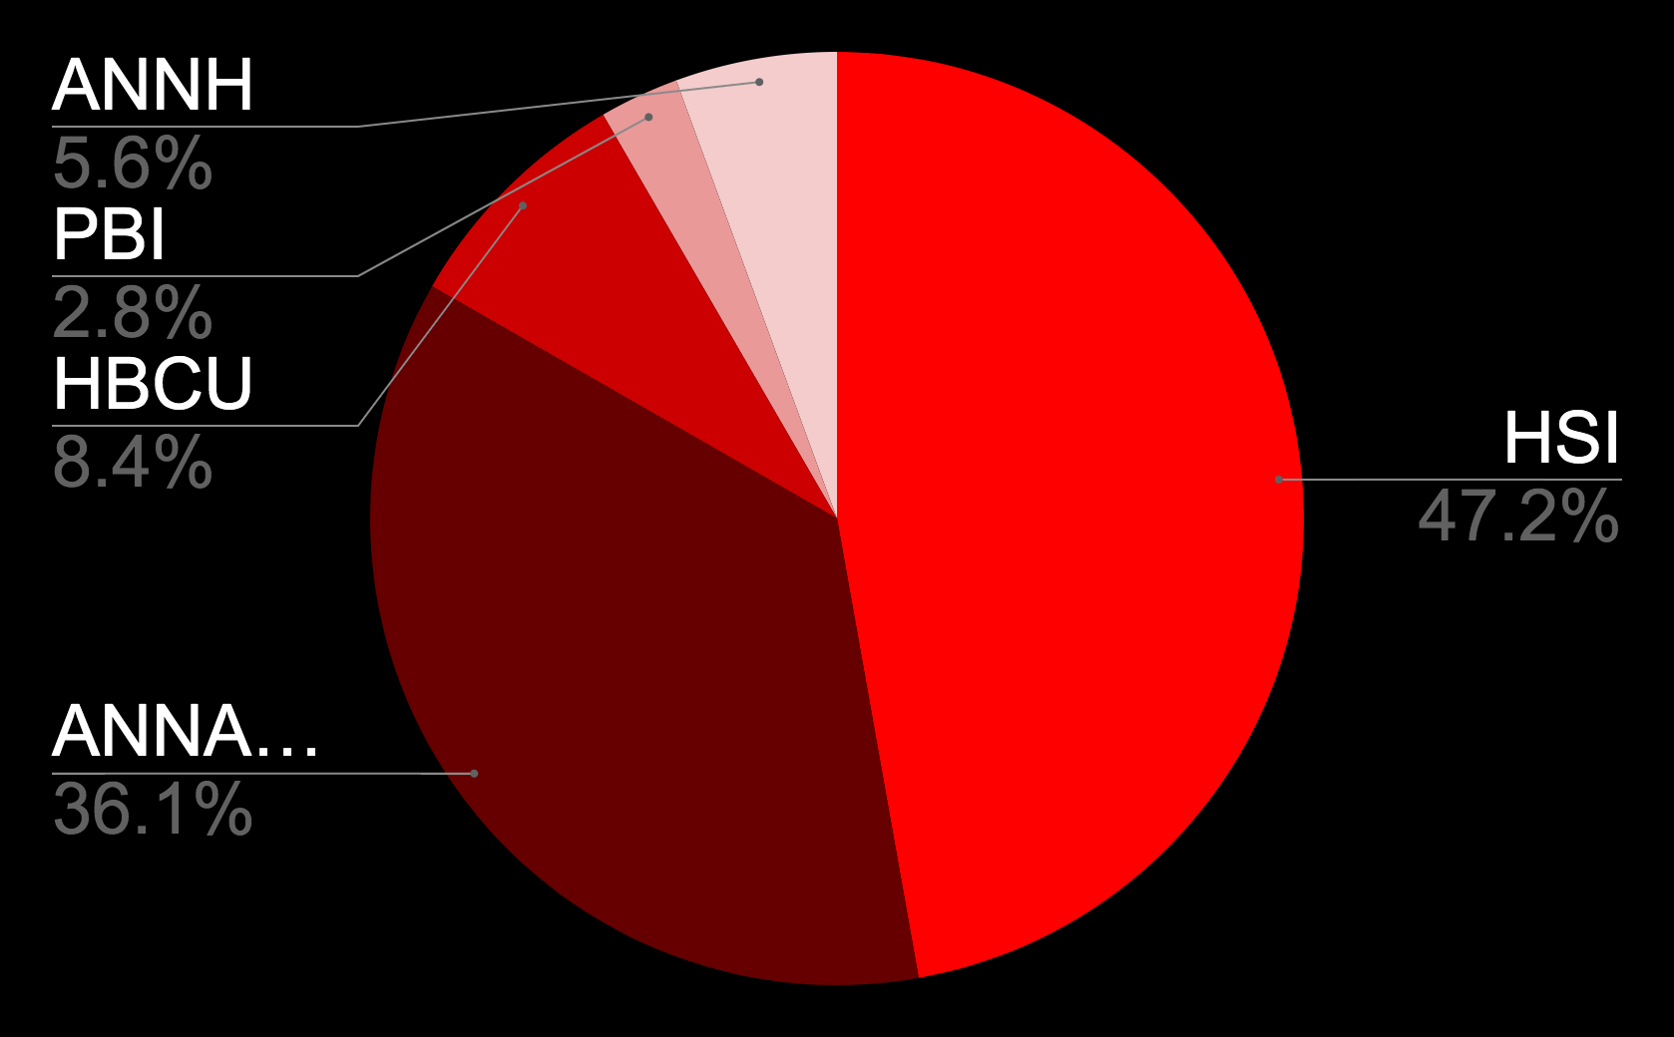
190 institutions with graduate degrees in physics offered [1]
188 institutions offer a 4-year degree in physics
74.5% R1 Institutions
22.3% R2 Institutions
6 institutions not classified [2]
69.7% Public
30.3% Private [2]
16.5% Minority Serving Institutions [3]
Buzzell Quantifying the Quantum Curriculum 3

Slide 8
190 institutions with graduate degrees in physics offered [1]
188 institutions offer a 4-year degree in physics
74.5% R1 Institutions
22.3% R2 Institutions
6 institutions not classified [2]
69.7% Public
30.3% Private [2]
16.5% Minority Serving Institutions [3]
56.7% Physics Bachelors in 2021-22 [4]
Buzzell Quantifying the Quantum Curriculum 3

Slide 9
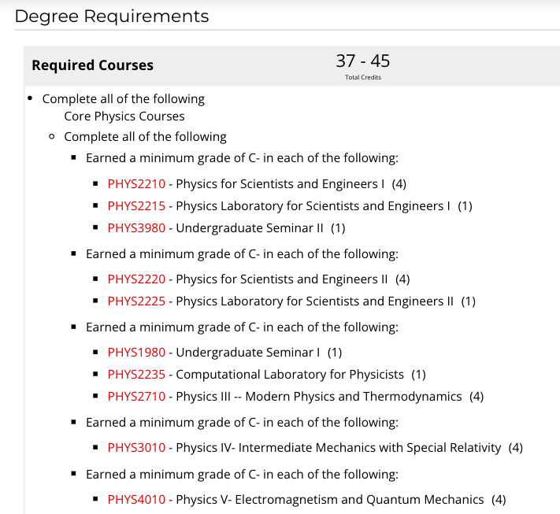
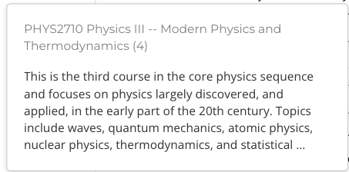
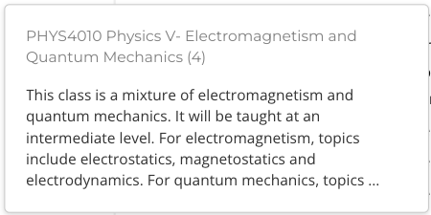
Buzzell Quantifying the Quantum Curriculum 4

Slide 10
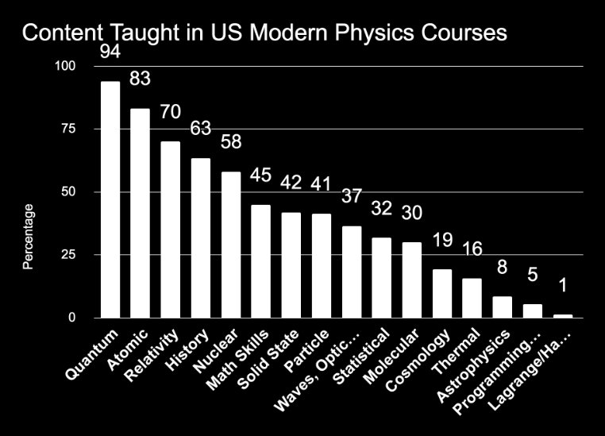
Based on results from Modern Physics Syllabi analysis, all course descriptions with "modern physics" or "modern topics" listed were included
Buzzell Quantifying the Quantum Curriculum 5

Slide 11
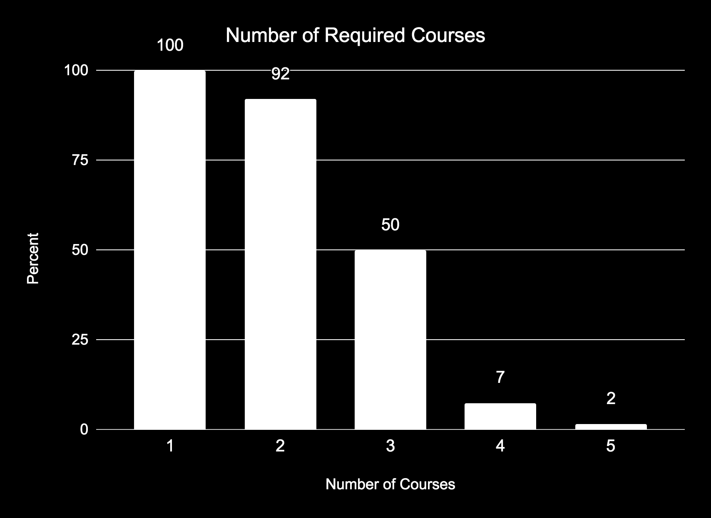
Buzzell Quantifying the Quantum Curriculum 6

Slide 12
Q2: How many instructional hours on quantum concepts are physics students required to take to graduate with a four-year degree?
Buzzell Quantifying Quantum Curriculum 7

Slide 13
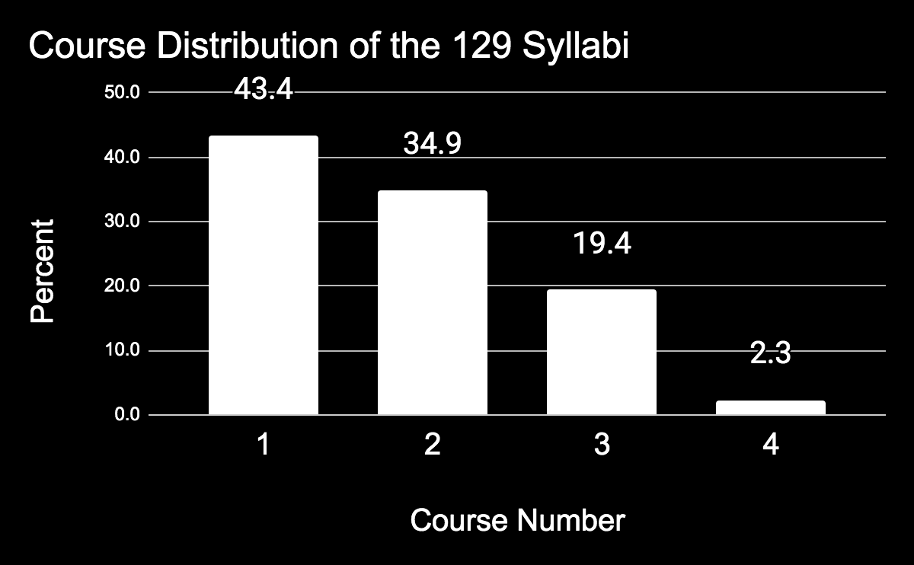
188 institutions offer a 4-year degree in physics
Obtained syllabi from all required courses with quantum concepts from 56 institutions
129 syllabi
51.2% obtained publicly
48.8% obtained from private correspondence
Buzzell Quantifying the Quantum Curriculum 8

Slide 14
Schrödinger
Schrödinger Equation
Photoelectric Effect
Wave-Particle Duality
Operators
Eigenvalues
Tunneling/Reflection
Stern-Gerlach Experiment
Dirac Notation
States
Quantum Measurement
Expectation Value
Uncertainty
Superposition
Mixed States
Quantization
Fermi’s Golden Rule
Photons
Pauli’s Exclusion Principle
Square Well
Identical Particles
Matter Waves
Frank Hertz Experiment
Wave Mechanics
Wave Functions
Wave Properties of Particles
Particle Properties of Waves
de Broglie Hypothesis
Quantum Theory of Light
Blackbody Radiation
Planck’s Postulate
Spin
Lecture needs to cover one of the following topics to be coded as covering quantum concepts:
Buzzell Quantifying the Quantum Curriculum 9

Slide 15
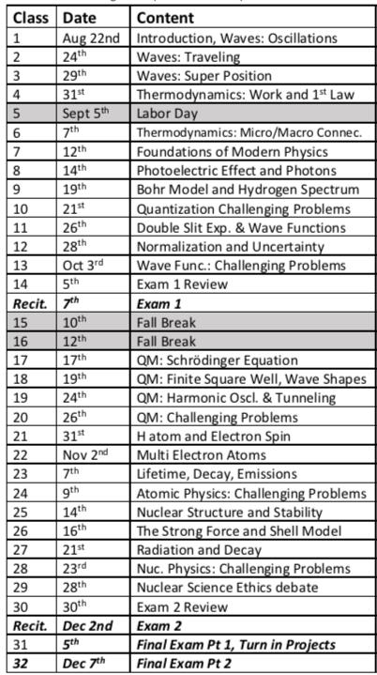
80 minutes per lecture
1,200 Minutes on QM concepts (20 Hours)
15 QM Lectures
Buzzell Quantifying the Quantum Curriculum 10

Slide 16
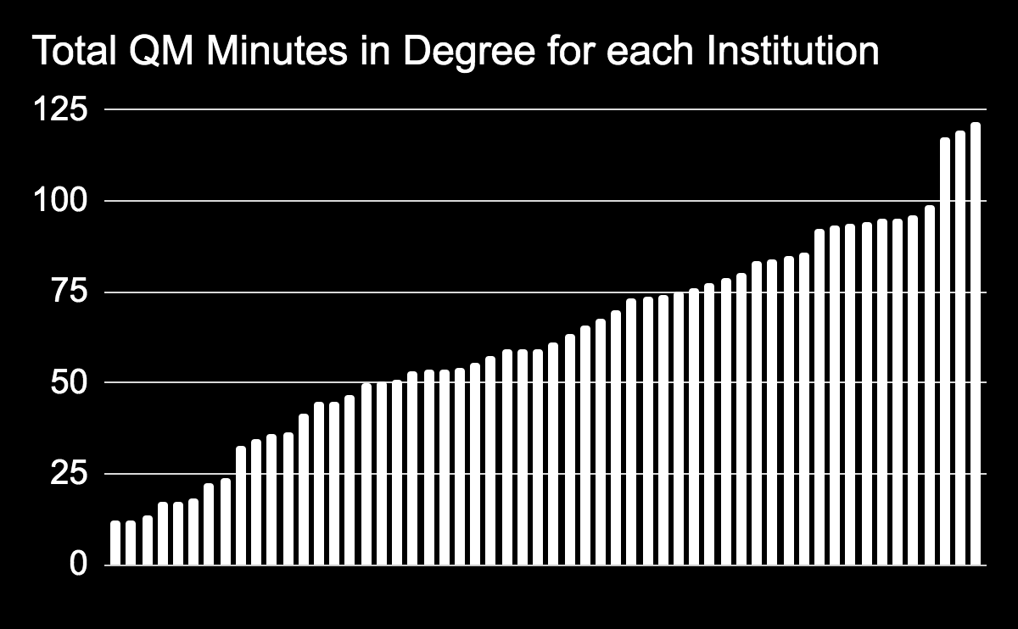
Mean: 62.5 Hours
Median: 60.3 Hours
Min: 12 Hours
Max: 121.7 Hours
Standard Deviation: 28.1 Hours
Buzzell Quantifying the Quantum Curriculum 11

Slide 17
Q3: What quantum topics are students required to learn before graduation?
Buzzell Quantifying the Quantum Curriculum 12

Slide 18
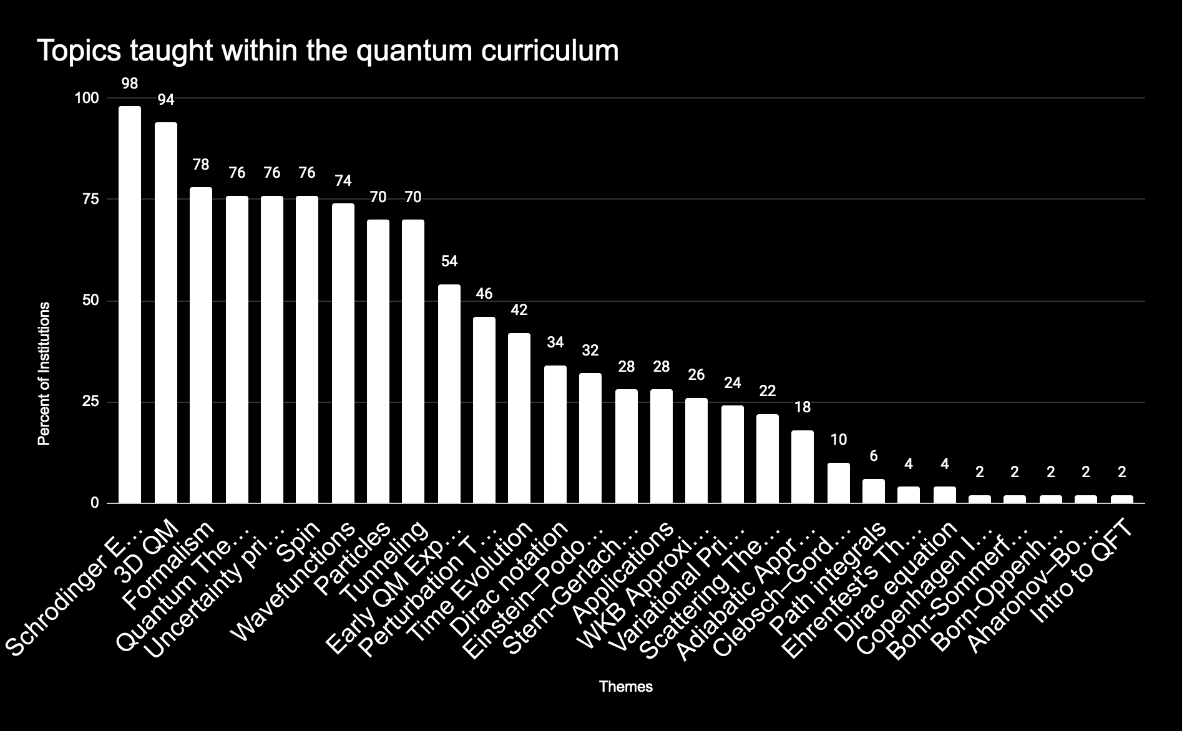
Buzzell Quantifying the Quantum Curriculum 13

Slide 19
SGE only included in 28% despite being known to aide students in discerning between physical space and Hilbert space [18]
Buzzell Quantifying the Quantum Curriculum 13

Slide 20
Q4: Are institutions utilizing a spins-first or position-first approach when teaching quantum?
Buzzell Quantifying the Quantum Curriculum 14

Slide 21
Coding used to determine spin-first vs. position-first paradigm
Spin-First | Position-First
Stern-Gerlach experiment [6] Postulates of quantum mechanics [5, 6] Schrödinger equation in context of spin ½ particles [5] Matrix equations [6] Eigenvalue equations regularly used before Schrödinger equation introduced [5] McIntyre’s textbook used [5, 8] | Schrödinger equation introduced early on [5,6] Schrödinger equation used in context of position space wavefunctions [5] Differential equations [5] Griffith’s textbook used [5,7] Time independent Schrödinger equation is first eigenvalue equation introduced [5]
Buzzell Quantifying the Quantum Curriculum 15

Slide 22
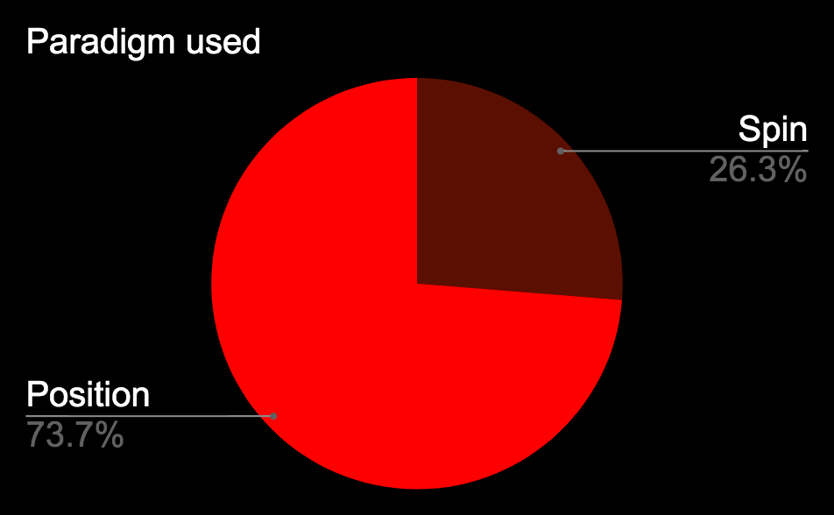
Buzzell Quantifying the Quantum Curriculum 16

Slide 23
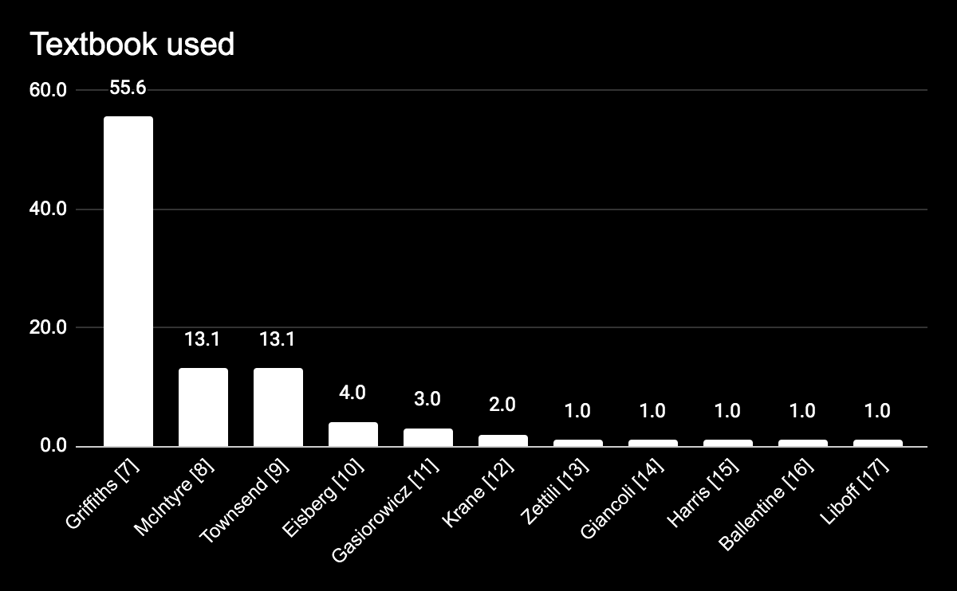
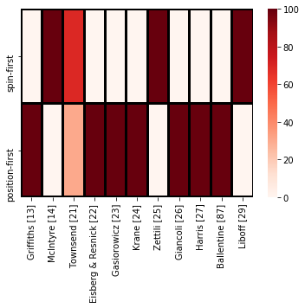
Buzzell Quantifying the Quantum Curriculum 17

Slide 24
Summary:
Quantum curriculum varies widely at research intensive institutions in the US
Instructors still using position-first approach and focusing course on solutions to the TISE
SGE not commonly introduced in undergraduate courses
Buzzell Quantifying the Quantum Curriculum 18

Slide 25
References:
[1] US News Rankings,
https://www.usnews.com/best-graduate-schools/top-science-schools/physics-rankings
[2] CARNEGIE CLASSIFICATION OF INSTITUTIONS OF HIGHER EDUCATION,
https://carnegieclassifications.acenet.edu/.
[3] University of California, Irvine, MSI Directory,
https://inclusion.uci.edu/core-programs/minority-thriving-campus/msi-directory/
[4] S. Nicholson, P. Mulvey, Roster of Physics Departments with Enrollment and Degree Data,
AIP (2021).
[5] G. Passante, Energy measurement resources in spins-first and position-first quantum
mechanics, presented at the Physics Education Research Conference 2016, Sacramento, CA, 2016.
[6] H. Sadaghiani and J. Munteanu, Spin First instructional approach to teaching quantum
mechanics in sophomore level modern physics courses, presented at the Physics Education Research Conference 2015, College Park, MD, 2015.
[7] D. J. Griffiths, D. F. Schroeter, Introduction to Quantum Mechanics, (Cambridge University
Press).
[8] D. McIntyre, Quantum Mechanics: A Paradigms Approach, (Pearson).
[9] J. S. Townsend, A Modern Approach to Quantum Mechanics, (University Science Books).
[10] R. M. Eisberg, R. Resnick, Quantum Physics of Atoms, Molecules, Solids, Nuclei, and
Particles, (John Wiley & Sons).
[11] S. Gasiorowicz, Quantum Physics, (Wiley).
[12] K. S. Krane, Modern Physics, (John Wiley & Sons).
[13] N. Zettili, Quantum Mechanics: Concepts and Applications, (Wiley).
[14] D. Giancoli, Physics for Scientists & Engineers with Modern Physics, (Pearson).
[15] R. Harris, Modern Physics, (Pearson).
[16] L. E. Ballentine, Quantum Mechanics: A Modern Development, (World Scientific
Publishing Co).
[17] R. Liboff, Introductory Quantum Mechanics, (Addison-Wesley).
[18]G. Zhu, C. Singh, AIP Conf. Proc. 1179, 309–312 (2009).
Buzzell Quantifying the Quantum Curriculum 19

